Slide 1
Reflections
What I have learnt from the people of Waterloo, Sierra Leone.
In any partnership there is giving and receiving.

Slide 2
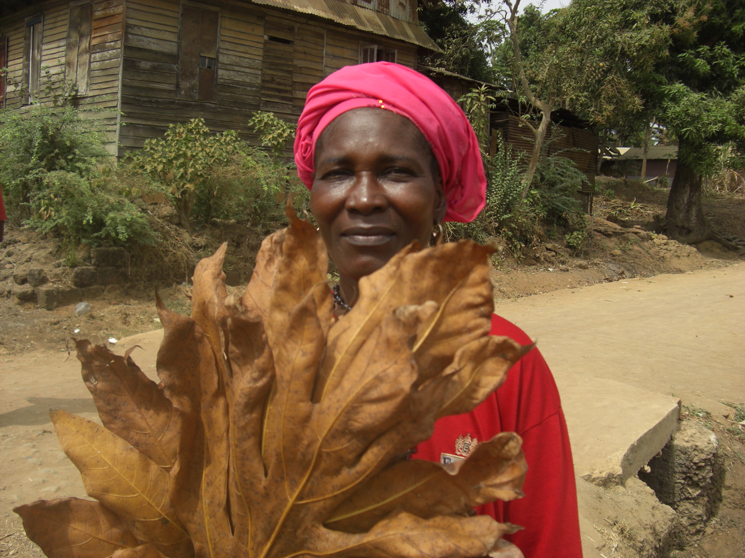

Slide 3
Jane Roberts
I've learnt so much from our partners in Sierra Leone. However, I think the single most valuable lesson is to try remain and positive even when life is difficult. This isn't easy but, compared to the hardships that are faced on a daily basis in Sierra Leone, we are the lucky ones! So my New Year's resolution - once again - will be to remain positive as we can't change what has passed, we don't know what tomorrow brings and so to be happy for today!
Former trustee and secretary

Slide 4
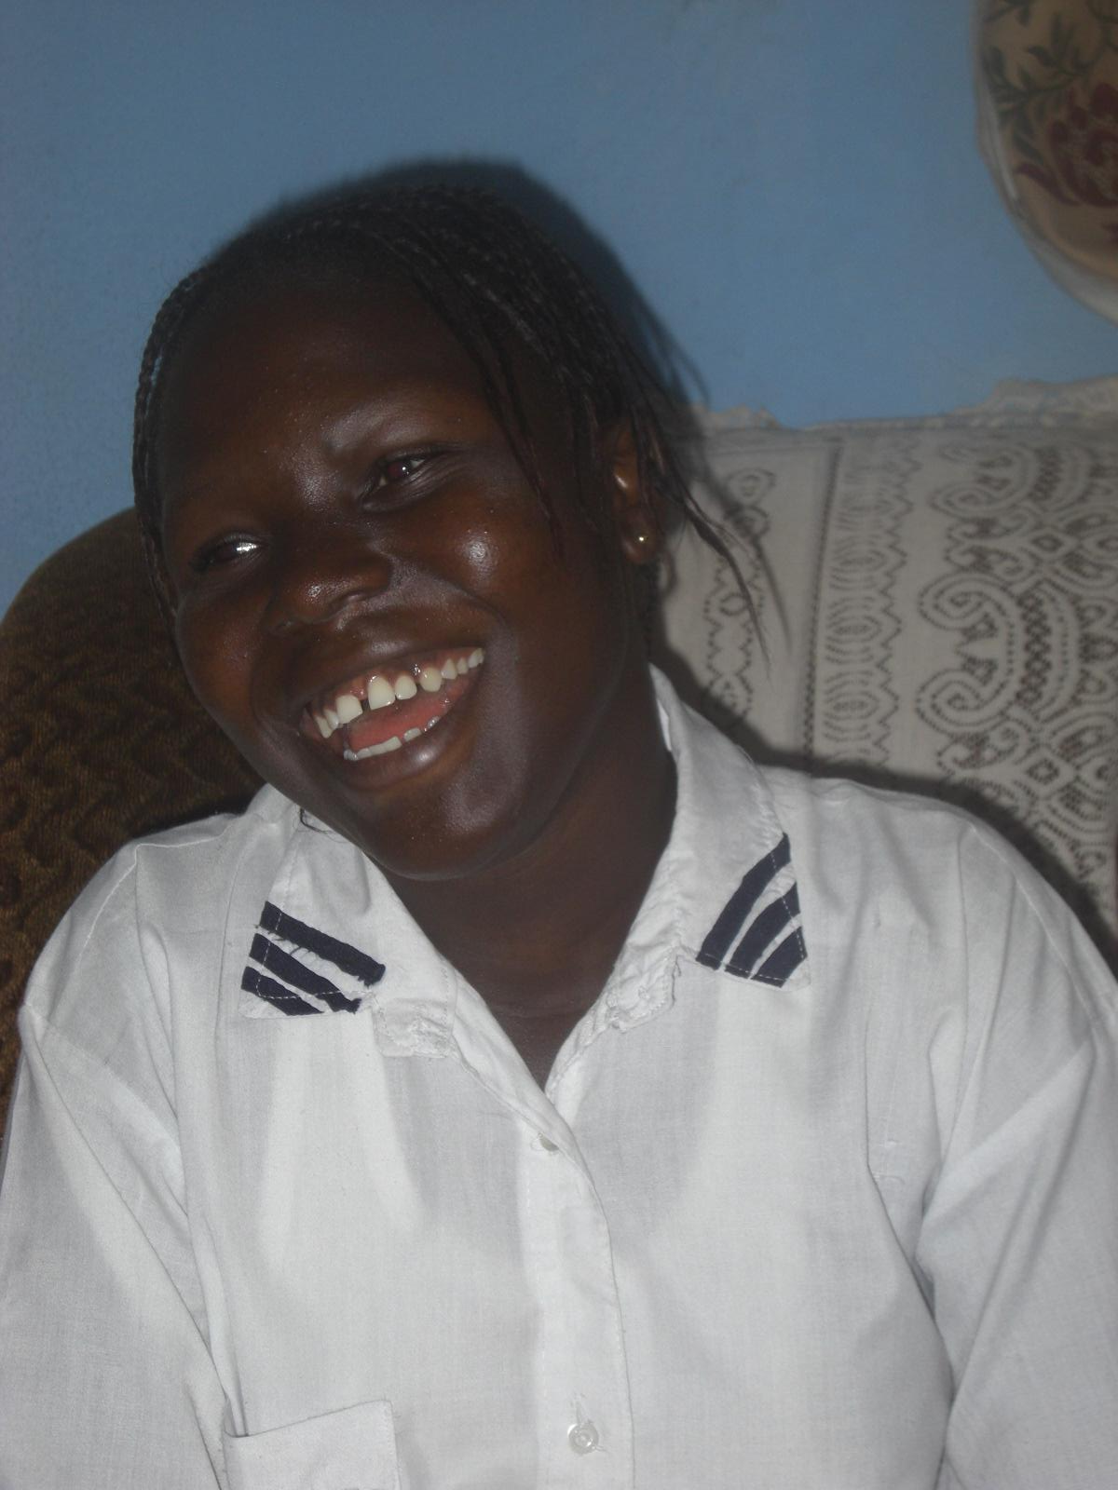

Slide 5
Teresa McLaughlin
From 2005, when the Waterloo Partnership was founded, people here and in Sierra Leone, whom I would never have come to know in any circumstances, have enriched my life through their:
generosity of spirit;
commitment to a cause;
faith in human beings;
persistence in the face of adversity;
determination to make a difference to the lives of others;
capacity to love unconditionally;
hope in God and each other.
Through all their endeavours, may the members and friends of the Waterloo Partnership continue to be a source of inspiration in our troubled world.
Co- Founder of the Waterloo Partnership
Former chairperson and trustee

Slide 6
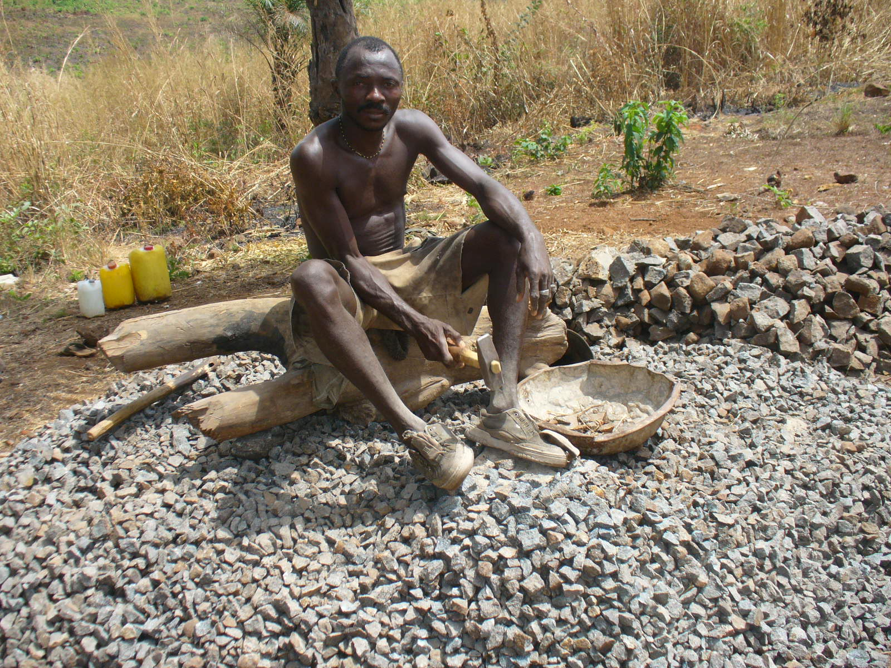
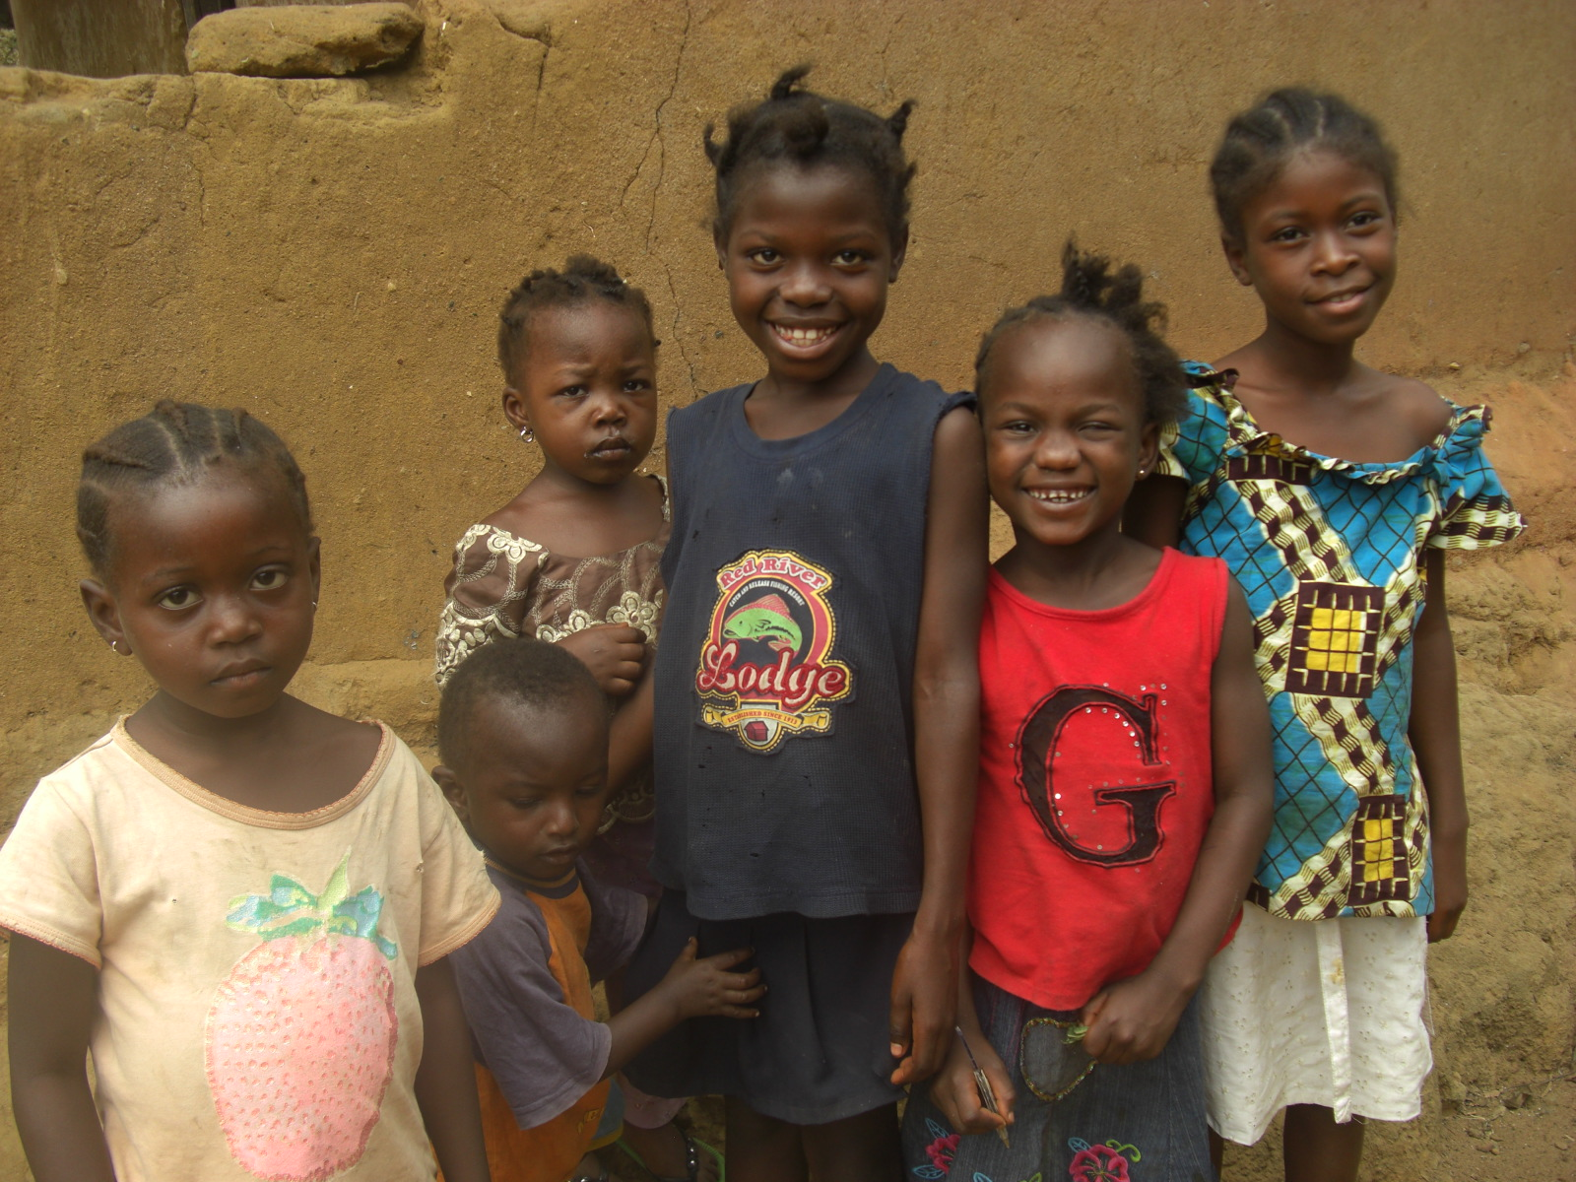

Slide 7
Fred Nye
'When I consider the difficulties of life in Sierra Leone and the courage and generosity of its people, it helps to keep our problems in the West very much in perspective'.
Chairperson and trustee

Slide 8
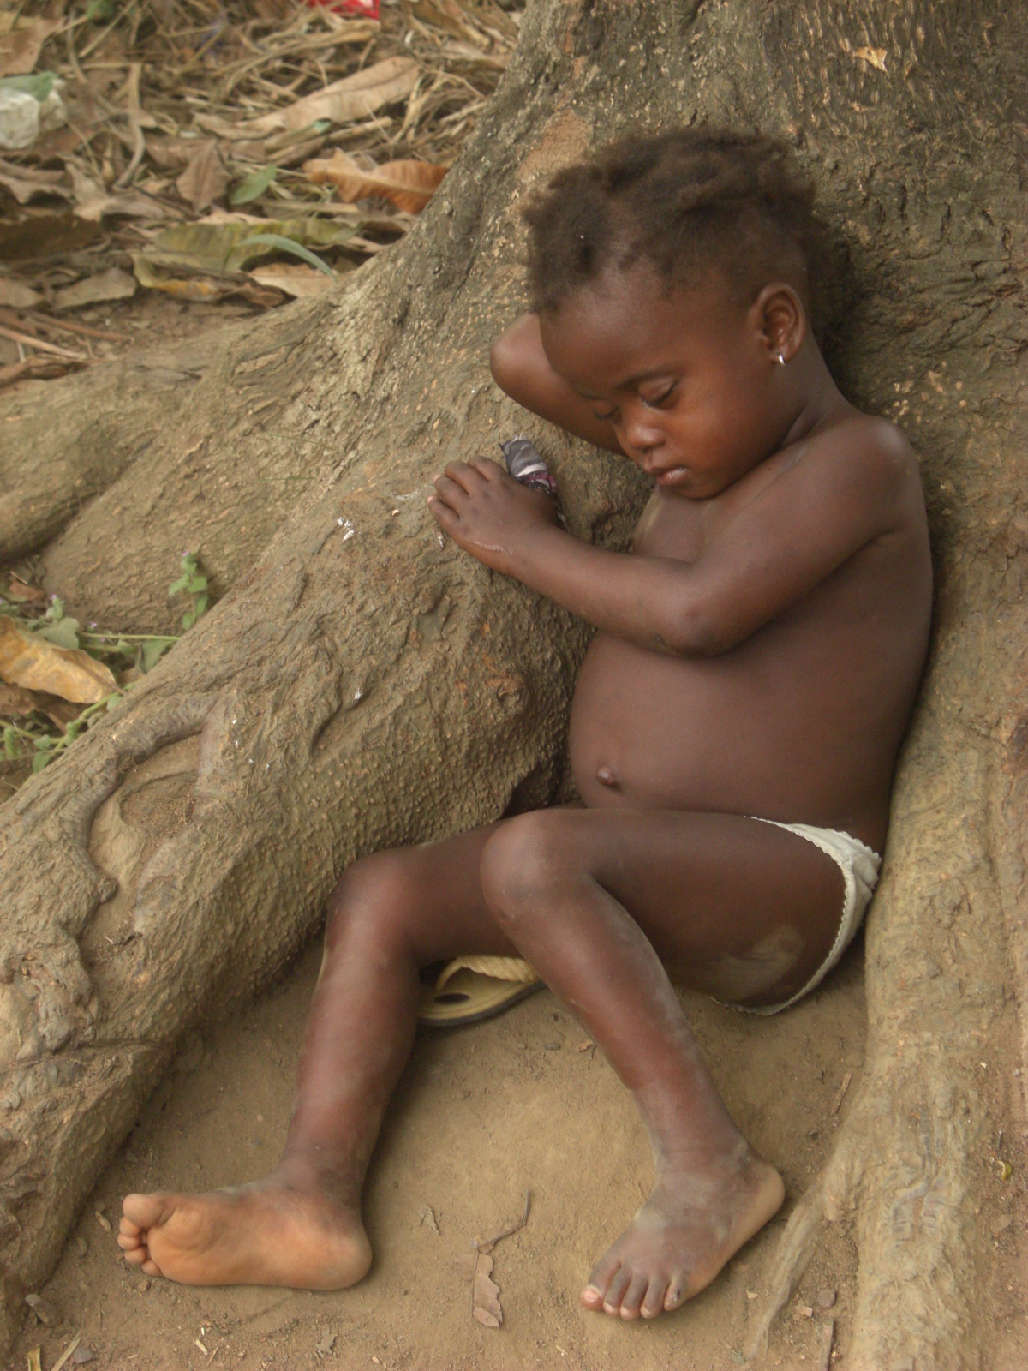

Slide 9
Mary Corbett
Sierra Leone has given me the opportunity to see the humility and bravery of a country who might have given up yet haven't; the kindness and generosity behind people's giving; the opportunity to see a community who have been given hope in the future.
Trustee

Slide 10
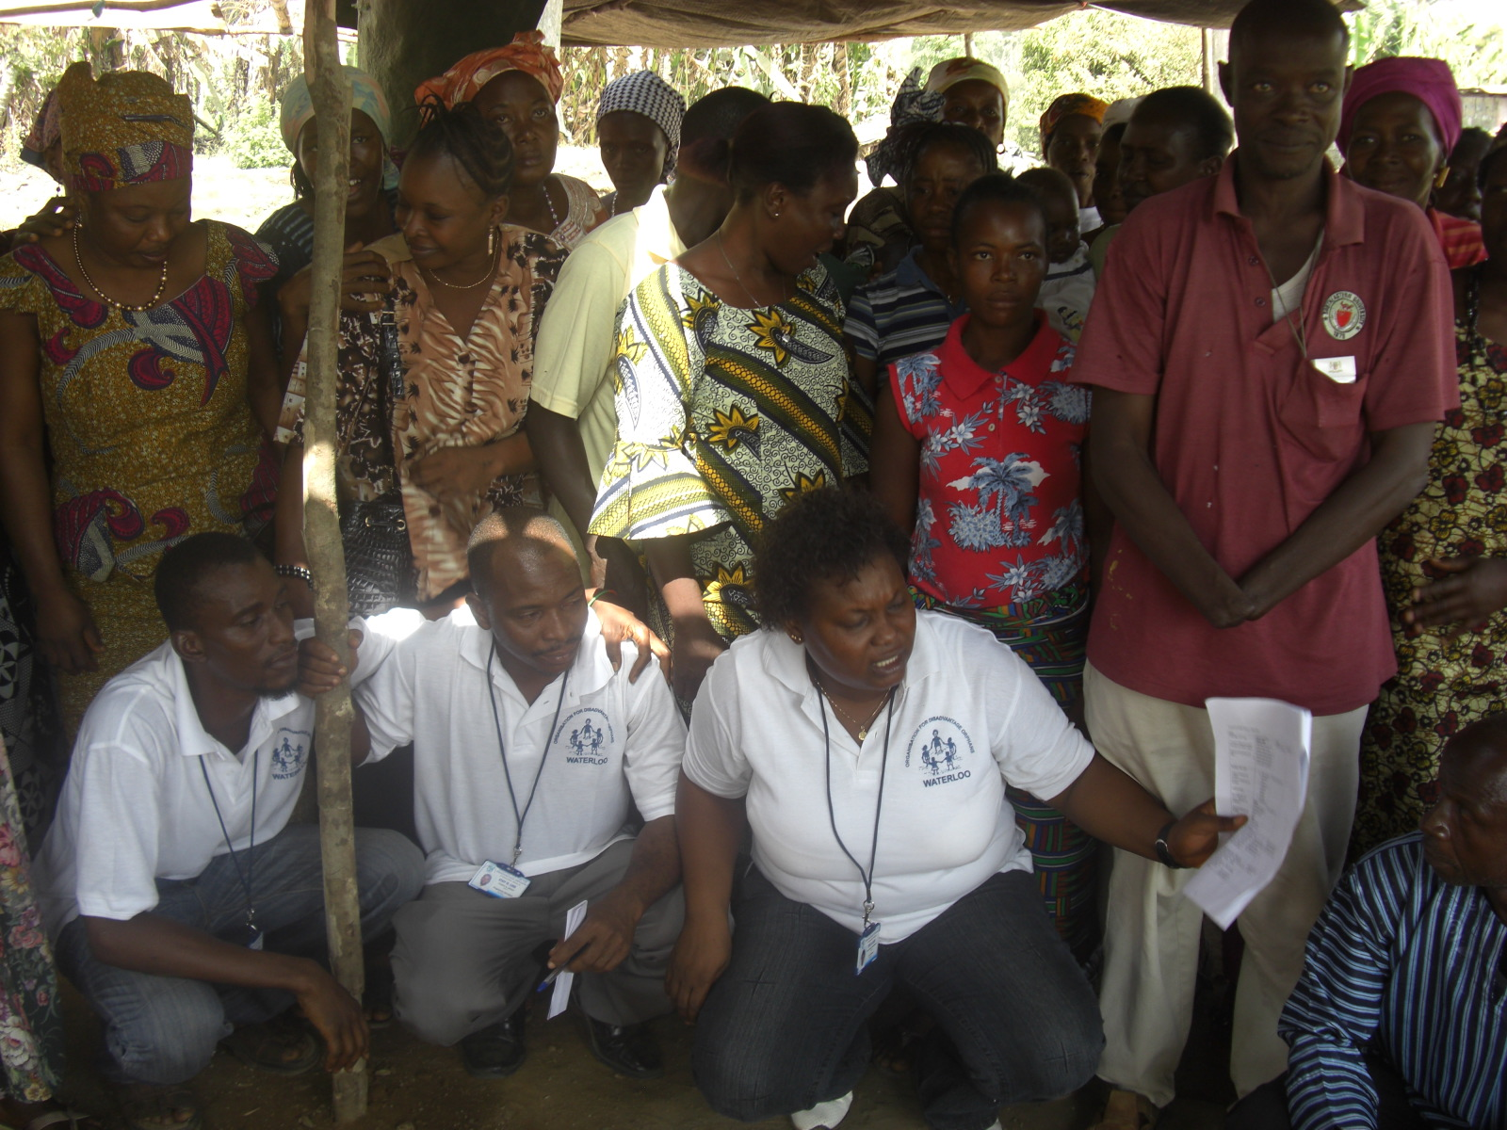

Slide 11
David Moorhead
On the first visit I only saw poverty and devastation from the war. It was harrowing and depressing.
The second time I went I saw the people. They were so brave, hopeful and determined. The poverty was secondary to these amazing folks.
I have never met such dedicated teachers, who struggle with such little resources and such large class sizes. They have a true vocation for teaching.
I have never met such generous parents, who open their homes to the street children. They could so easily argue that they are too poor to care for the orphans but they don’t.
On the surface they seem a people with nothing but I found so many people there with big smiles and even bigger hearts.
I hope I have learnt to be like them, even if it is in a small way.
Former trustee and treasurer

Slide 12
